Slide 1



APPLICATION FOR ACKNOWLEDGEMENT OF THE HUMAN RESOURCES STRATEGY FOR RESEARCHERS INCORPORATING THE CHARTER AND THE CODE (HRS4R)
EXCELLENCE IN RESEARCH
www.urv.cat
Notes:
1

Slide 2
Índex
0. Introduction to HRS4R
Introducing the Universitat Rovira i Virgili (URV)
Towards HRS4R Excellence
The approach
  STEP 1: Internal Analysis
  STEP 2: Action Plan
  STEP 3: Application for EC acknowledgment
  OTHER STEPS
4. Annexes - Documents

Slide 3
0. INTRODUCTION TO HRS4R

Slide 4

Introduction to HRS4R
                The "Human Resources Strategy for Researchers Incorporating the Charter & Code" (HRS4R) is a procedure designed by the European Commission to assist research institutions in the implementation of the Charter and Code of Conduct (C&CC).
                The Universitat Rovira i Virgili endorsed the C&CD in 2008 and is now participating in the fourth cohort of this European programme.
                Up to now, more than 200 European institutions have received the acknowledgement and can use the logo (step 3/5)

Slide 5
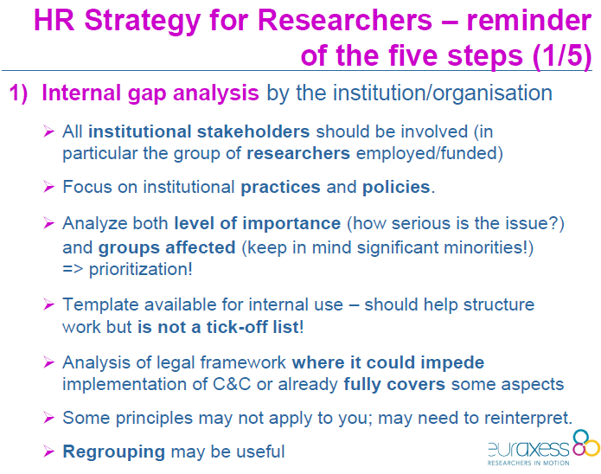
Introduction to HRS4R
Human Resources Strategy Researchers (HRS4R)

Slide 6
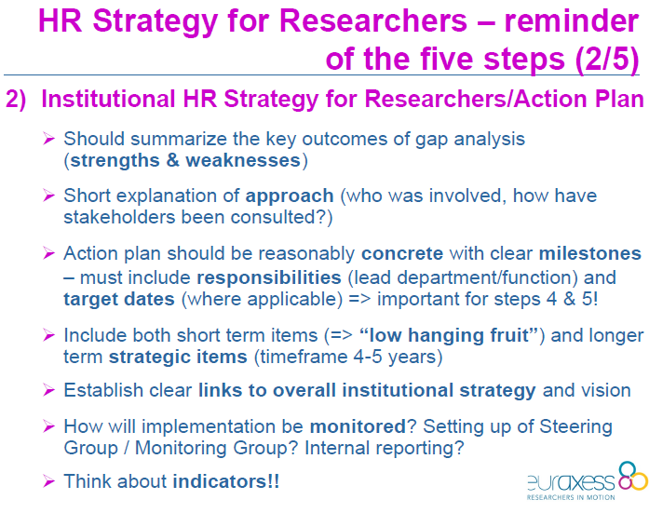
Introduction to HRS4R
Human Resources Strategy Researchers (HRS4R)

Slide 7
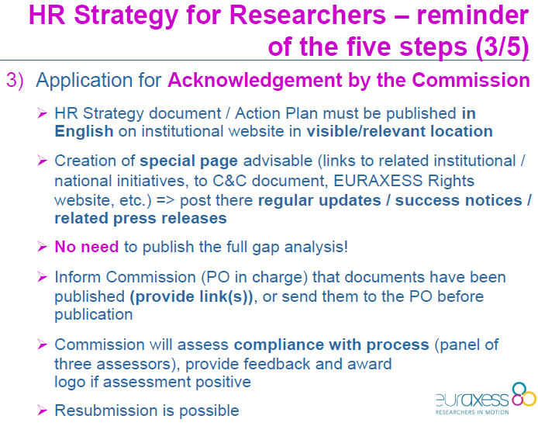
Introduction to HRS4R
Human Resources Strategy Researchers (HRS4R)

Slide 8
Introduction to HRS4R
Human Resources Strategy Researchers (HRS4R)

Slide 9
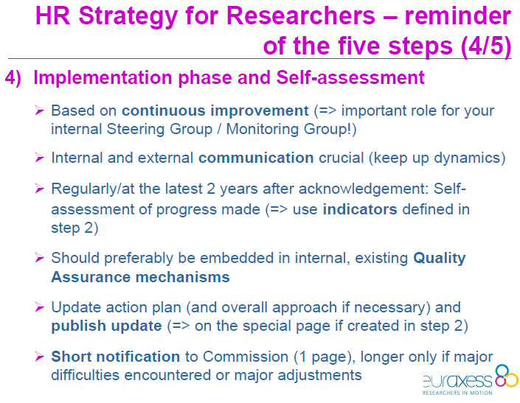
Introduction to HRS4R
Human Resources Strategy Researchers (HRS4R)

Slide 10
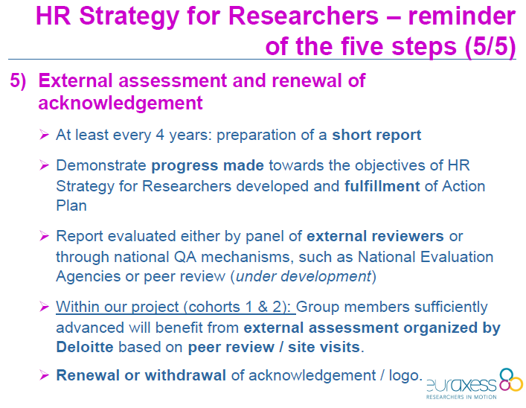
Introduction to HRS4R
Human Resources Strategy Researchers (HRS4R)

Slide 11
APLICATION HR – EXCELLENCE IN RESEARCH
1. INTRODUCING THE URV
www.urv.cat
Notes:
11

Slide 12
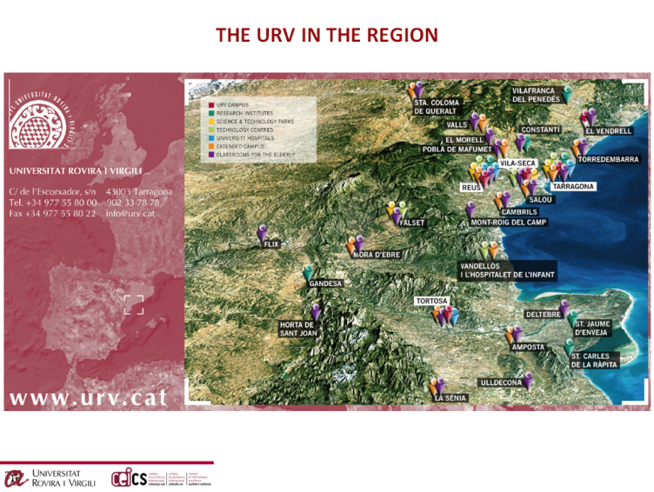
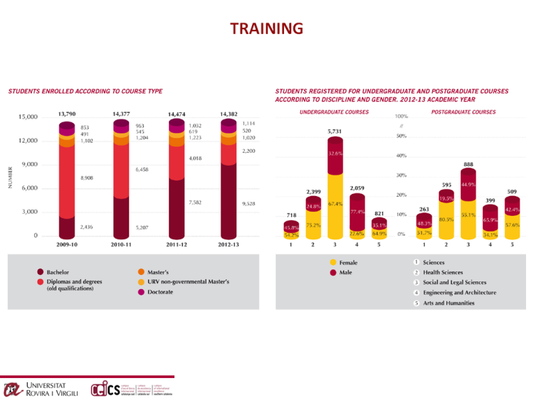
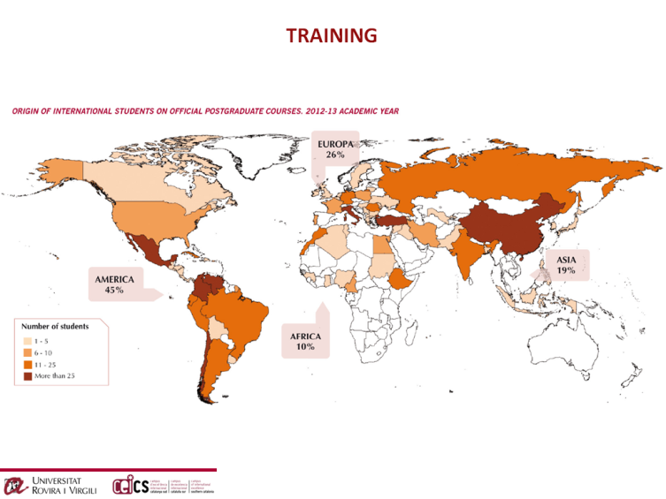
                Introducing the URV
OVERVIEW OF THE URV 2014
(click to download)

Slide 13
APLICATION HR – EXCELLENCE IN RESEARCH
APLICATION HR – EXCELLENCE IN RESEARCH
2. TOWARDS HRS4R-EXCELLENCE
Towards excellence in human resources
www.urv.cat
Notes:
13

Slide 14
                Towards HRS4R-Excellence
Towards Excellence in Human Resources
Staff policy
The URV is seeking to be ranked as one of the top universities in Europe.
Staff policy is important if the University is to achieve its strategic objectives because it promotes the quality of employees and creates conditions in which employees can perform to their optimum capacity.
In the coming years, the university's staff policy will focus more on providing support in priority areas. This means that particular attention will be paid to employees directly engaged in research and education or involved in direct supporting these processes.

Slide 15
                Towards HRS4R-Excellence
Towards Excellence in Human Resources
Staff policy
An effective staff policy requires
(1) focus on particular issues,
(2) continuity in the issues selected,
(3) cohesion among the issues.
The university's long-term staff policy focuses on
  leadership development,
  employee development,
  organizational development

Slide 16
                Towards HRS4R-Excellence
Towards Excellence in Human Resources
Career Development of Researchers
The university's long-term staff policy focuses on staff development.
The implementation of the Charter for Researchers and the Code of Conduct for the Recruitment of Researchers supports the career development of researchers.
Open and transparent recruitment processes ensure that vacancies are advertised to all candidates (both internal and external) and curtail underhanded appointments.

Slide 17
                Towards HRS4R-Excellence
Towards Excellence in Human Resources
Career Development of Researchers
Open and transparent recruitment and selection processes promote employment opportunities for researchers (particularly young ones) and mobility both within the university (internal mobility) and between universities (external mobility).
The Universitat Rovira i Virgili is committed to the open and transparent recruitment of academic researchers since it promotes and improves the quality of the academic work force.

Slide 18
APLICATION HR – EXCELLENCE IN RESEARCH
3. THE APPROACH
Applied Methodology. HRS4R
www.urv.cat
Notes:
18

Slide 19
                The approach
Applied Methodology. HRS4R
Participating in the HRS4R requires the university to endorse the principles of the Charter and Code.
The Universitat Rovira i Virgili welcomes and supports the Recommendation of the European Commission 2005/251/EC on "The European Charter for Researchers" and "The Code of Conduct for the Recruitment of Researchers". The text was approved by the Governing Council of the University on 28th December, 2008.

Slide 20
                The approach
Applied Methodology. HRS4R
The HRS4R consists of five steps:
  1. Internal analysis
  2. Action plan
  3. Acknowledgment
  4. Self-assessment
  5. External assessment
Further information: http://ec.europa.eu/euraxess/index.cfm/rights/whatIsAResearcher

Slide 21
                The approach
Applied Methodology. HRS4R
STEP 1. INTERNAL ANALYSIS. URV’S DOCUMENT ANALYSIS (I)
Methodology
A standard format can be used for the internal analysis (Step 1), which must result in an action plan (Step 2).
The URV internal analysis has three tracks:
  1. An inventory of external legal regulations relating to the various principles of the Charter and Code of Conduct (document analysis).
  2. An inventory of internal regulations (document analysis)
  3. An inventory of practices relating to the various principles of the Charter and Code of Conduct (best practice analysis).
The URV RDI Manager carried out the document analysis (inventory of laws and regulations) in conjunction with the Quality Department and HR Department. The internal analysis template document was filled in and a matrix was constructed using principles and legislation/internal rules/internal practices.
Representatives of researchers (from R1 to R4) participated and validated the internal analysis via their participation on the Research and Knowledge Transfer URV Commission and the Human Resources URV Commission. Both commissions are gender and knowledge area balanced, to guarantee an broader and equal vision on research concerning aspects.

Slide 22
                The approach
Applied Methodology. HRS4R
STEP 1. URV’S DOCUMENT ANALYSIS (II)
Results
The inventory demonstrates that the principles have largely been reflected in the URV’s rules and regulations. Nearly every principle of the Charter and Code of Conduct can be referenced.
Most internal regulations and best practices have been adopted after a highly participative process. These processes often involved (see matrix for more details)
  core research and a technical team, who designed the proposed document,
  open consultation
  presentation to and approval by the competent commission (with representatives of researchers and technical staff)
  presentation to and approval by the Governing Council
  presentation to and approval by the Board of Trustees

Slide 23
                The approach
Applied Methodology. HRS4R
STEP 1. URV’S DOCUMENT ANALYSIS (II)
Results
A significant number of the rules and regulations also relate to rules and regulations that apply to all Catalan and Spanish universities. It is therefore apparent that, given these commonalities, a single gap analysis could be carried out for all Catalan and Spanish universities.
The document analysis discovered that three areas of the current rules need tightening (see next section).

Slide 24
                The approach
Applied Methodology. HRS4R
STEP 2. ACTION PLAN (I)
The Action Plan brings planned legal and practical issues into line with the principles of the Charter and Code of Conduct. The input for the Action Plan comes from the document analysis (inventory of rules and regulations).
The current Action Plan outlines actions that can be taken to improve URV both institutionally and methodologically.

Slide 25
                STEP 2. ACTION PLAN (II)
Gap analysis - Principles to improve
Code principle | Action to be implemented
1. Research freedom 3. Professional responsibility 4. Professional attitude 5. Contractual and legal obligations 7. Good practice in research 8. Dissemination, exploitation of results | A1. “Best Practices in Research” open consultation and board approval
30. Access to career advice | A2. Career advice to PhD students in their 3rd year
37. Supervision and managerial duties | A3. Specific training for PhD supervisors
38. Continuing professional development | A4. Specific training on how to get external funding for RDI

Slide 26
                STEP 2. ACTION PLAN (III)
Action plan
Action | Who | When | How | Deliverables
A1. “Best Practices in Research” | Quality department + Virector of Research | Dec 2013 | Open consultation + board approval | Document - code
A2. Career advice to PhD students in their 3rd year | Career Development Centre - ICE | Oct 2014 | Via specific courses | Increase in job seeking and success.
A3. Specific training for PhD supervisors | Doctoral School | Dec 2013 Dec 2014 | Via internal and external experts | Results of the course – Follow-up indicators
A4. Specific traing on how to get external funding for RDI | OTRC - URV | Nov 2013 Des 2014 | Courses, infodays, workshops | Events and success indicators

Slide 27
STEP 3. APPLICATION for EC acknowledgment
- Information on the internal analysis
- Approval of the Action Plan
- External (web) communication of the Action Plan
OTHER STEPS
STEP 4. Implement the Action Plan and self-assessment
STEP 5. External assessment and renewal of the acknowledgement

Slide 28
                Annexes - Documents
Internal analysis
Matrix internal analysis
Web presentation
(available upon request)

Slide 29


www.urv.cat

